Slide 1

Software Engineering
教材
Ian Sommerville , Software Engineering （英文版 第10版 ）. 北京：机械工业出版社，2017.9
参考书目
孙家广,刘强, 软件工程 高等教育出版社
许家饴,曾翎, 软件工程 高等教育出版社
Abran, A. and J. Moore, SWEBOK: Guide to the Software Engineering Body of Knowledge, IEEE Computer Society Press, can be download at http://www.swebok.org/
教师
计算机科学与技术学院计算机系 吴军华
E-mail: wujh@njtech.edu.cn
Mobile: 13770697578
总学时
36+12学时

Slide 2
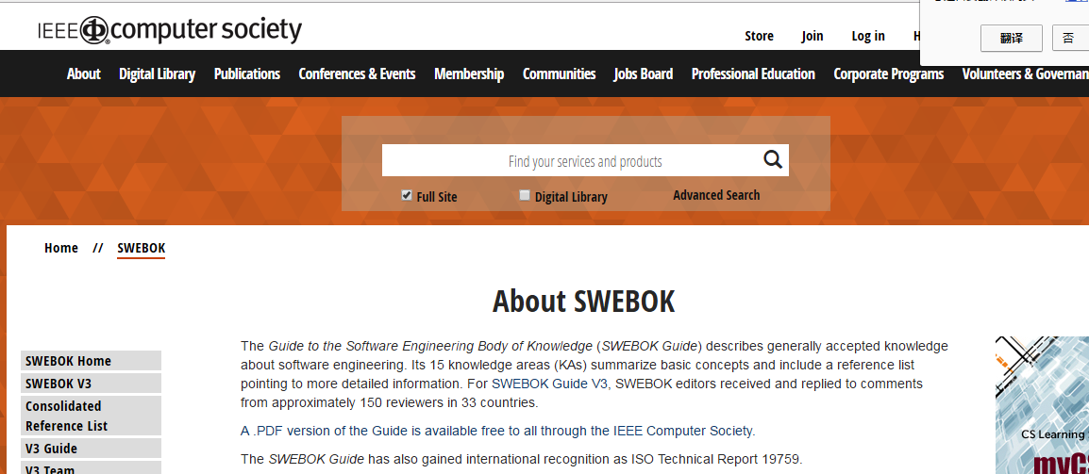

Slide 3
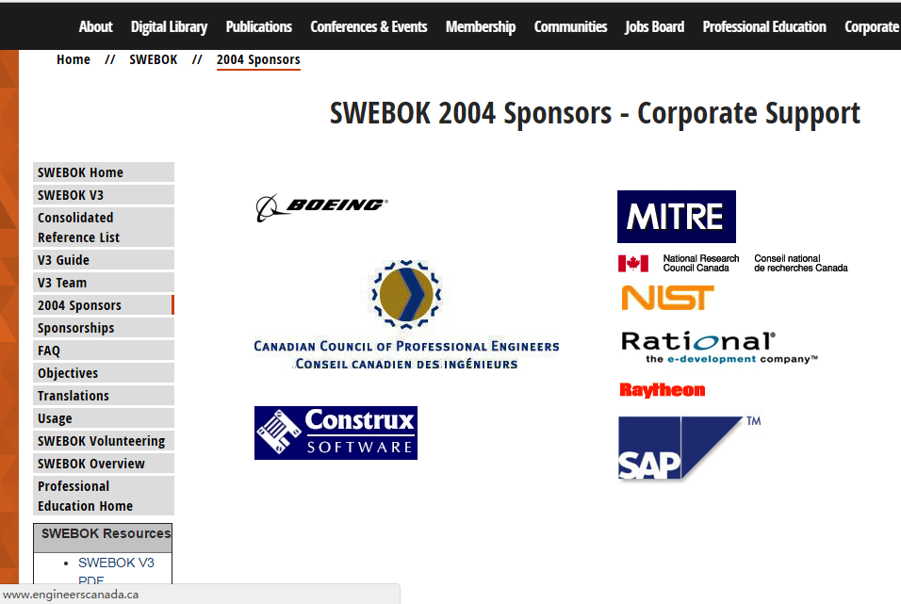

Slide 4
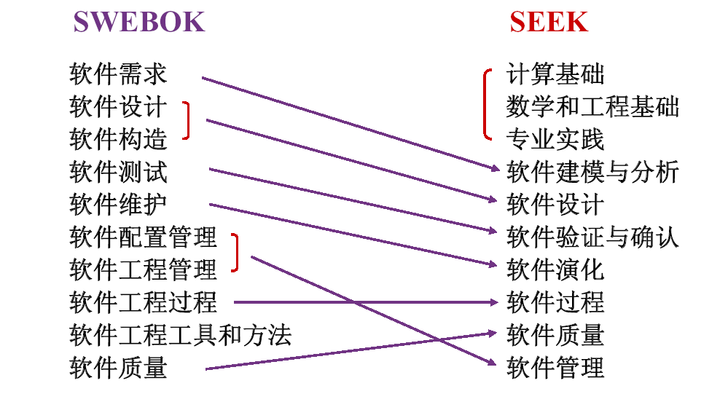
Software Engineering Body of Knowledge

Slide 5
美国军方：对计算机最有影响的10人
Charles Babbage: 可编程计算机
Ada King: 第一个程序员
Alan Kay:面向对象之父
Alan Turing:计算机之父、人工智能之父
Capers Jones:功能点度量
Watts Humphrey:软件质量之父
Barry Boehm:成本估算模型
Tim Berners-Lee：Web之父
Grace Hopper：第一个编译器
Ed Yourdon: 结构化分析与设计
大多数与软件有关！
Notes:
Alan Kay：有争议，但面向对象编程之名由其提出
Alan Turing：英国数学家

Slide 6
Chapter 1- Introduction

Slide 7
Topics covered
Professional software development
What is meant by software engineering.
Software engineering ethics
A brief introduction to ethical issues that affect software engineering.
Case studies
An introduction to three examples that are used in later chapters in the book.
Chapter 1 Introduction

Slide 8
Why is software important?
The economies of ALL developed nations are dependent on software.
More and more systems are software controlled
Expenditure on software represents a significant fraction of GNP in all developed countries.
Notes:
Gross National Product

Slide 9
Software products
Generic products
Stand-alone systems that are marketed and sold to any customer who wishes to buy them.
Examples – PC software such as graphics programs, project management tools; CAD software; software for specific markets such as appointments systems for dentists.
Customized products
Software that is commissioned by a specific customer to meet their own needs.
Examples – embedded control systems, air traffic control software, traffic monitoring systems.
Chapter 1 Introduction

Slide 10
Product specification
Generic products
The specification of what the software should do is owned by the software developer and decisions on software change are made by the developer.
Customized products
The specification of what the software should do is owned by the customer for the software and they make decisions on software changes that are required.
Chapter 1 Introduction

Slide 11
Software engineering is proposed
In 1968 at a conference “NATO”
Resulting from software crisis
Software become larger and more complex
Development schedule is always delayed
The software costs much more than predicted
The software was unreliable, was difficult to maintain

Slide 12
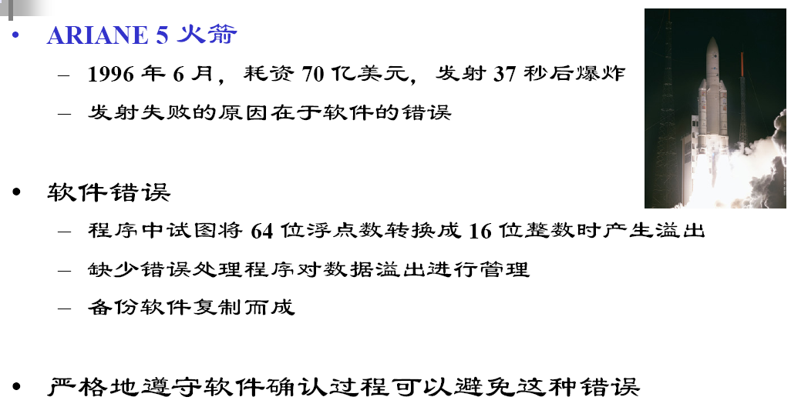
Why is software engineering needed? Some samples about software errors

Slide 13
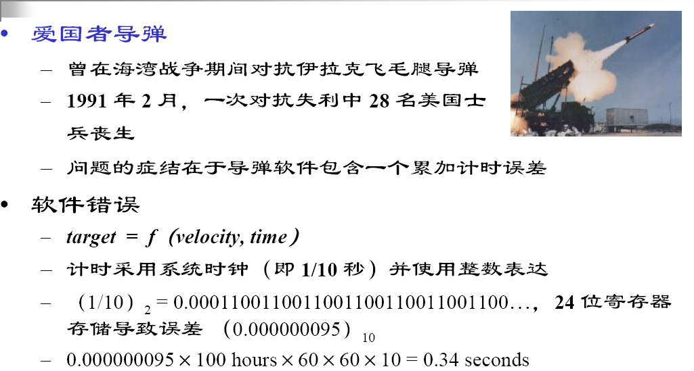

Slide 14
2012-08-01 纽约证券交易所，股票券商“骑士资本”高额交易损失4.4亿美元
原因：软件算法缺陷
2011-08-18 俄罗斯“质子-M”火箭发射失败
原因：火箭推进器控制系统程序编写错误

Slide 15
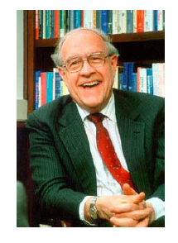
From “The Mythical Man-month”
No silver bullet: essence and accidents of software engineering
Fred Brooks，IBM OS360 Project Manager
1999 年图灵奖获得者
“没有任何技术或管理上的进展，能够独立地许诺十年内使生产率、可靠性或简洁性获得数量上的进步。”

Slide 16
Frequently asked questions about software engineering
Question | Answer
What is software? | Computer programs and associated documentation. Software products may be developed for a particular customer or may be developed for a general market.
What are the attributes of good software? | Good software should deliver the required functionality and performance to the user and should be maintainable, dependable and usable.
What is software engineering? | Software engineering is an engineering discipline that is concerned with all aspects of software production.
What are the fundamental software engineering activities? | Software specification, software development, software validation and software evolution.
What is the difference between software engineering and computer science? | Computer science focuses on theory and fundamentals; software engineering is concerned with the practicalities of developing and delivering useful software.
What is the difference between software engineering and system engineering? | System engineering is concerned with all aspects of computer-based systems development including hardware, software and process engineering. Software engineering is part of this more general process.
Chapter 1 Introduction

Slide 17
Frequently asked questions about software engineering
Question | Answer
What are the key challenges facing software engineering? | Coping with increasing diversity, demands for reduced delivery times and developing trustworthy software.
What are the costs of software engineering? | Roughly 60% of software costs are development costs, 40% are testing costs. For custom software, evolution costs often exceed development costs.
What are the best software engineering techniques and methods? | While all software projects have to be professionally managed and developed, different techniques are appropriate for different types of system. For example, games should always be developed using a series of prototypes whereas safety critical control systems require a complete and analyzable specification to be developed. You can’t, therefore, say that one method is better than another.
What differences has the web made to software engineering? | The web has led to the availability of software services and the possibility of developing highly distributed service-based systems. Web-based systems development has led to important advances in programming languages and software reuse.
Chapter 1 Introduction

Slide 18
Essential attributes of good software
Product characteristic | Description
Maintainability | Software should be written in such a way so that it can evolve to meet the changing needs of customers. This is a critical attribute because software change is an inevitable requirement of a changing business environment.
Dependability and security | Software dependability includes a range of characteristics including reliability, security and safety. Dependable software should not cause physical or economic damage in the event of system failure. Malicious users should not be able to access or damage the system.
Efficiency | Software should not make wasteful use of system resources such as memory and processor cycles. Efficiency therefore includes responsiveness, processing time, memory utilisation, etc.
Acceptability | Software must be acceptable to the type of users for which it is designed. This means that it must be understandable, usable and compatible with other systems that they use.
Chapter 1 Introduction

Slide 19
Software engineering
Software engineering is an engineering discipline that is concerned with all aspects of software production from the early stages of system specification through to maintaining the system after it has gone into use.
Engineering discipline
Using appropriate theories and methods to solve problems bearing in mind organizational and financial constraints.
All aspects of software production
Not just technical process of development. Also project management and the development of tools, methods etc. to support software production.
Chapter 1 Introduction

Slide 20
Software process activities
Software specification, where customers and engineers define the software that is to be produced and the constraints on its operation.
Software development, where the software is designed and programmed.
Software validation, where the software is checked to ensure that it is what the customer requires.
Software evolution, where the software is modified to reflect changing customer and market requirements.
Chapter 1 Introduction

Slide 21
General issues that affect most software
Heterogeneity
Increasingly, systems are required to operate as distributed systems across networks that include different types of computer and mobile devices.
Business and social change
Business and society are changing incredibly quickly as emerging economies develop and new technologies become available. They need to be able to change their existing software and to rapidly develop new software.
Security and trust
As software is intertwined with all aspects of our lives, it is essential that we can trust that software.
Chapter 1 Introduction

Slide 22
Software engineering diversity
There are many different types of software system and there is no universal set of software techniques that is applicable to all of these.
The software engineering methods and tools used depend on the type of application being developed, the requirements of the customer and the background of the development team.
Chapter 1 Introduction

Slide 23
Application types
Stand-alone applications
These are application systems that run on a local computer, such as a PC. They include all necessary functionality and do not need to be connected to a network.
Interactive transaction-based applications
Applications that execute on a remote computer and are accessed by users from their own PCs or terminals. These include web applications such as e-commerce applications.
Embedded control systems
These are software control systems that control and manage hardware devices. Numerically, there are probably more embedded systems than any other type of system.
Chapter 1 Introduction

Slide 24
Application types
Batch processing systems
These are business systems that are designed to process data in large batches. They process large numbers of individual inputs to create corresponding outputs.
Entertainment systems
These are systems that are primarily for personal use and which are intended to entertain the user.
Systems for modeling and simulation
These are systems that are developed by scientists and engineers to model physical processes or situations, which include many, separate, interacting objects.
Chapter 1 Introduction

Slide 25
Application types
Data collection systems
These are systems that collect data from their environment using a set of sensors and send that data to other systems for processing.
Systems of systems
These are systems that are composed of a number of other software systems.
Chapter 1 Introduction

Slide 26
Software engineering fundamentals
Some fundamental principles apply to all types of software system, irrespective of the development techniques used:
Systems should be developed using a managed and understood development process. Of course, different processes are used for different types of software.
Dependability and performance are important for all types of system.
Understanding and managing the software specification and requirements (what the software should do) are important.
Where appropriate, you should reuse software that has already been developed rather than write new software.
Chapter 1 Introduction
Notes:
Irrespective: 无关的

Slide 27
Web software engineering
Software reuse is the dominant approach for constructing web-based systems.
When building these systems, you think about how you can assemble them from pre-existing software components and systems.
Web-based systems should be developed and delivered incrementally.
It is now generally recognized that it is impractical to specify all the requirements for such systems in advance.
User interfaces are constrained by the capabilities of web browsers.
Technologies such as AJAX allow rich interfaces to be created within a web browser but are still difficult to use. Web forms with local scripting are more commonly used.
Chapter 1 Introduction

Slide 28
Web-based software engineering
Web-based systems are complex distributed systems but the fundamental principles of software engineering discussed previously are as applicable to them as they are to any other types of system.
The fundamental ideas of software engineering, discussed in the previous section, apply to web-based software in the same way that they apply to other types of software system.
Chapter 1 Introduction

Slide 29
Software engineering ethics
Software engineering involves wider responsibilities than simply the application of technical skills.
Software engineers must behave in an honest and ethically responsible way if they are to be respected as professionals.
Ethical behaviour is more than simply upholding the law but involves following a set of principles that are morally correct.

Slide 30
ACM/IEEE Code of Ethics
The professional societies in the US have cooperated to produce a code of ethical practice.
Members of these organisations sign up to the code of practice when they join.
The Code contains eight Principles related to the behaviour of and decisions made by professional software engineers, including practitioners, educators, managers, supervisors and policy makers, as well as trainees and students of the profession.

Slide 31
The ACM/IEEE Code of Ethics
Software Engineering Code of Ethics and Professional Practice
ACM/IEEE-CS Joint Task Force on Software Engineering Ethics and Professional Practices
PREAMBLE
The short version of the code summarizes aspirations at a high level of the abstraction; the clauses that are included in the full version give examples and details of how these aspirations change the way we act as software engineering professionals. Without the aspirations, the details can become legalistic and tedious; without the details, the aspirations can become high sounding but empty; together, the aspirations and the details form a cohesive code.
Software engineers shall commit themselves to making the analysis, specification, design, development, testing and maintenance of software a beneficial and respected profession. In accordance with their commitment to the health, safety and welfare of the public, software engineers shall adhere to the following Eight Principles:
Chapter 1 Introduction

Slide 32
Ethical principles
1. PUBLIC - Software engineers shall act consistently with the public interest.
2. CLIENT AND EMPLOYER - Software engineers shall act in a manner that is in the best interests of their client and employer consistent with the public interest.
3. PRODUCT - Software engineers shall ensure that their products and related modifications meet the highest professional standards possible.
4. JUDGMENT - Software engineers shall maintain integrity and independence in their professional judgment.
5. MANAGEMENT - Software engineering managers and leaders shall subscribe to and promote an ethical approach to the management of software development and maintenance.
6. PROFESSION - Software engineers shall advance the integrity and reputation of the profession consistent with the public interest.
7. COLLEAGUES - Software engineers shall be fair to and supportive of their colleagues.
8. SELF - Software engineers shall participate in lifelong learning regarding the practice of their profession and shall promote an ethical approach to the practice of the profession.
Chapter 1 Introduction
Notes:
integrity and reputation ： 诚信和声誉

Slide 33
Ethical dilemmas
Disagreement in principle with the policies of senior management.
Your employer acts in an unethical way and releases a safety-critical system without finishing the testing of the system.
Participation in the development of military weapons systems or nuclear systems.

Slide 34
Case studies
A personal insulin pump
An embedded system in an insulin pump used by diabetics to maintain blood glucose control.
A mental health case patient management system
A system used to maintain records of people receiving care for mental health problems.
A wilderness weather station
A data collection system that collects data about weather conditions in remote areas.
Chapter 1 Introduction

Slide 35
Insulin pump control system
Collects data from a blood sugar sensor and calculates the amount of insulin required to be injected.
Calculation based on the rate of change of blood sugar levels.
Sends signals to a micro-pump to deliver the correct dose of insulin.
Safety-critical system as low blood sugars can lead to brain malfunctioning, coma and death; high-blood sugar levels have long-term consequences such as eye and kidney damage.
Chapter 1 Introduction

Slide 36
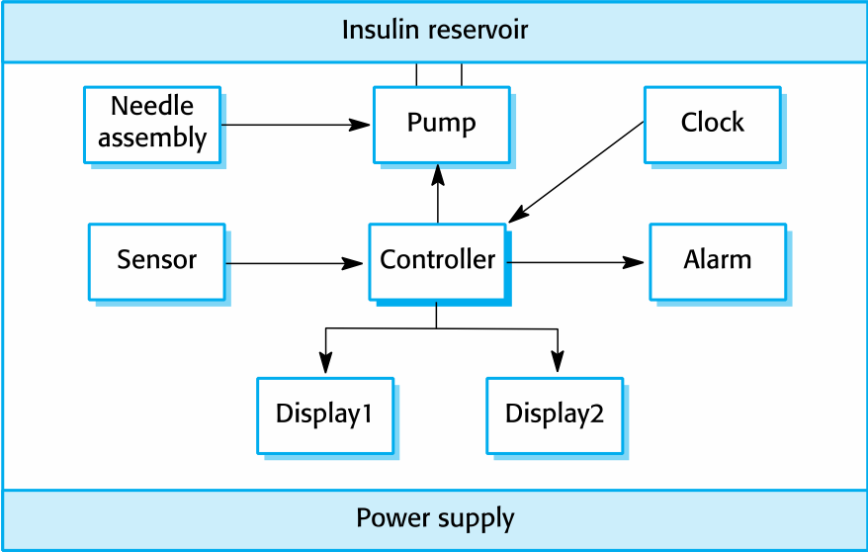
Insulin pump hardware architecture
Chapter 1 Introduction

Slide 37
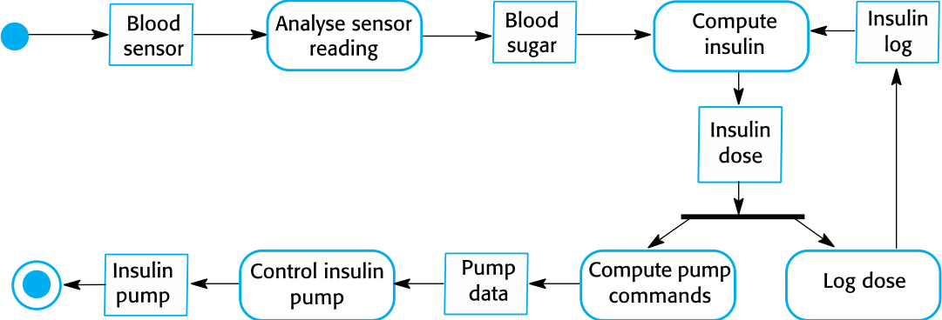
Activity model of the insulin pump
Chapter 1 Introduction

Slide 38
Essential high-level requirements
The system shall be available to deliver insulin when required.
The system shall perform reliably and deliver the correct amount of insulin to counteract the current level of blood sugar.
The system must therefore be designed and implemented to ensure that the system always meets these requirements.
Chapter 1 Introduction

Slide 39
A patient information system for mental health care
A patient information system to support mental health care is a medical information system that maintains information about patients suffering from mental health problems and the treatments that they have received.
Most mental health patients do not require dedicated hospital treatment but need to attend specialist clinics regularly where they can meet a doctor who has detailed knowledge of their problems.
To make it easier for patients to attend, these clinics are not just run in hospitals. They may also be held in local medical practices or community centres.
Chapter 1 Introduction

Slide 40
MHC-PMS
The MHC-PMS (Mental Health Care-Patient Management System) is an information system that is intended for use in clinics.
It makes use of a centralized database of patient information but has also been designed to run on a PC, so that it may be accessed and used from sites that do not have secure network connectivity.
When the local systems have secure network access, they use patient information in the database but they can download and use local copies of patient records when they are disconnected.
Chapter 1 Introduction

Slide 41
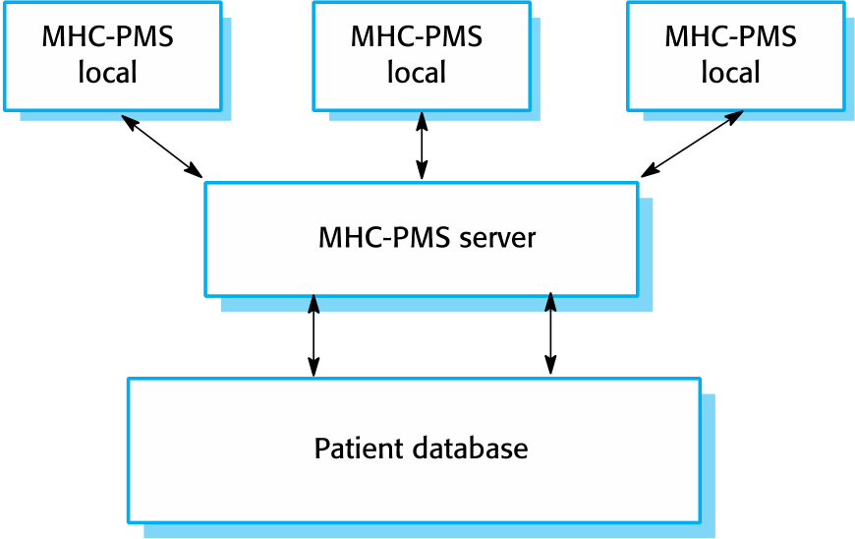
The organization of the MHC-PMS
Chapter 1 Introduction

Slide 42
MHC-PMS key features
Individual care management
Clinicians can create records for patients, edit the information in the system, view patient history, etc. The system supports data summaries so that doctors can quickly learn about the key problems and treatments that have been prescribed.
Patient monitoring
The system monitors the records of patients that are involved in treatment and issues warnings if possible problems are detected.
Administrative reporting
The system generates monthly management reports showing the number of patients treated at each clinic, the number of patients who have entered and left the care system, number of patients sectioned, the drugs prescribed and their costs, etc.
Chapter 1 Introduction

Slide 43
MHC-PMS concerns
Privacy
It is essential that patient information is confidential and is never disclosed to anyone apart from authorised medical staff and the patient themselves.
Safety
Some mental illnesses cause patients to become suicidal or a danger to other people. Wherever possible, the system should warn medical staff about potentially suicidal or dangerous patients.
The system must be available when needed otherwise safety may be compromised and it may be impossible to prescribe the correct medication to patients.
Chapter 1 Introduction

Slide 44
Wilderness weather station
The government of a country with large areas of wilderness decides to deploy several hundred weather stations in remote areas.
Weather stations collect data from a set of instruments that measure temperature and pressure, sunshine, rainfall, wind speed and wind direction.
The weather station includes a number of instruments that measure weather parameters such as the wind speed and direction, the ground and air temperatures, the barometric pressure and the rainfall over a 24-hour period. Each of these instruments is controlled by a software system that takes parameter readings periodically and manages the data collected from the instruments.
Chapter 1 Introduction

Slide 45
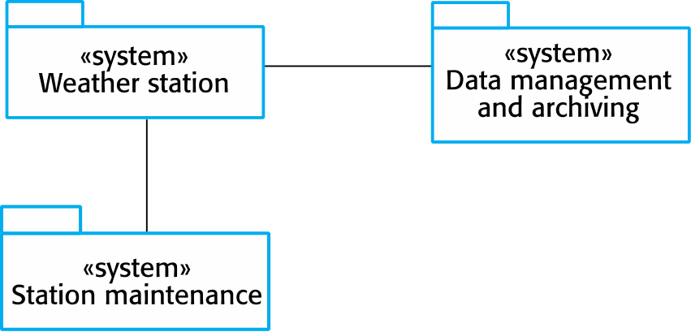
The weather station’s environment
Chapter 1 Introduction

Slide 46
Additional software functionality
Monitor the instruments, power and communication hardware and report faults to the management system.
Manage the system power, ensuring that batteries are charged whenever the environmental conditions permit but also that generators are shut down in potentially damaging weather conditions, such as high wind.
Support dynamic reconfiguration where parts of the software are replaced with new versions and where backup instruments are switched into the system in the event of system failure.
Chapter 1 Introduction

Slide 47
Key points
Software engineering is an engineering discipline that is concerned with all aspects of software production.
Essential software product attributes are maintainability, dependability and security, efficiency and acceptability.
The high-level activities of specification, development, validation and evolution are part of all software processes.
The fundamental notions of software engineering are universally applicable to all types of system development.
Chapter 1 Introduction

Slide 48
Key points
There are many different types of system and each requires appropriate software engineering tools and techniques for their development.
Chapter 1 Introduction

Slide 49
Key points
Software engineers have responsibilities to the engineering profession and society. They should not simply be concerned with technical issues.
Professional societies publish codes of conduct which set out the standards of behaviour expected of their members.
Three case studies are used in the book:
An embedded insulin pump control system
A system for mental health care patient management
A wilderness weather station

